Slide 1

Reverse Mortgages
Reference：
Chou-Wen Wang, Hong-Chih Huang, Yuan-Chi Miao, 2010,
Securitization of Crossover Risk in Reverse Mortgages
0253924 張錦炘

Slide 2
Outline
Review
Interest Rate Process
House Price Model
Mortality Model
Pricing Model for Reverse Mortgage Insurance
3D Lattice Method

Slide 3
Review

Slide 4
Mortgage
House
Borrower
Lump-Sum Payment
Lender

Slide 5
Mortgage
House
Principal + Interest
Borrower
Principal + Interest
Lender
Principal + Interest
Principal + Interest

Slide 6
Reverse Mortgage
House
Payment - Interest
Borrower
Payment - Interest
Lender
Payment - Interest
Payment - Interest

Slide 7
Reverse Mortgage
House
Borrower
Lender

Slide 8
review
Reverse mortgages are financial contracts that allow retirees to convert their home equities into either a lump sum or annuity income but still maintain ownership and residence until they die, sell or vacate their homes to live elsewhere.
There are three basic payment forms for reverse mortgages: (1) tenure, (2) term, or (3) line of credit.
Tenure - provides a monthly payment to the borrower as the borrower occupies the house
Term - provides monthly payments for only a fixed period
Line of Credit - permits the borrower to make draws at any time up to some maximum predetermined amount
The lender can only receive the minimum of the entire debt or the net value of the property, which prevents the borrower from owing more than the value of the property. This nonrecourse clause makes the reverse mortgage difficult to price.

Slide 9
Crossover risk
The reverse mortgage contracts involve a range of risks from the insurer’s perspective. The outstanding balance usually accumulates at a faster rate than the appreciating rate of the housing value; therefore, if the outstanding balance exceeds the housing value before the loan is settled, the lender starts to incur a loss－namely crossover risk, one of the crucial risks to manage in reverse mortgages.
This crossover risk is induced by three risk factors: interest rates, house prices and mortality rates.

Slide 10
Crossover risk
Assume that housing prices follow a Geometric Brownian motion (GBM) process. While the interest rate reflects the lognormal process of Black, Derman, and Toy (1990) and the mortality-related risks is assessed by the Lee-Carter model.
In this article, we use a three-dimensional lattice method which can simultaneously capture the evolution of housing price and short-term interest rate to calculate the fair valuation of reverse mortgages. For the housing price process, we use the Cox-Ross-Rubinstein (CRR, 1979) model to generate the possible states of future housing price. For the process of short-term interest rates, we use the Black-Derman-Toy (BDT, 1990) model to generate the possible states of future spot rates.

Slide 11
Interest rate process
Generally speaking, under the ordinary economic environment, we can assume the short-term risk-free interest rate is constant. However, in some circumstances, the short-term interest rate changes dramatically. For example, when the central bank suddenly changes monetary policies or oil shocks occur, the short-term interest rate will fluctuate over time. Thus, instead of using constant interest rate, we must assume the short term risk-free interest rate to be stochastic.
There are a number of models of the local process for the short-term interest rate. Among them, lognormal models keep the rate away from zero entirely, while the normal process may fall below zero.

Slide 12
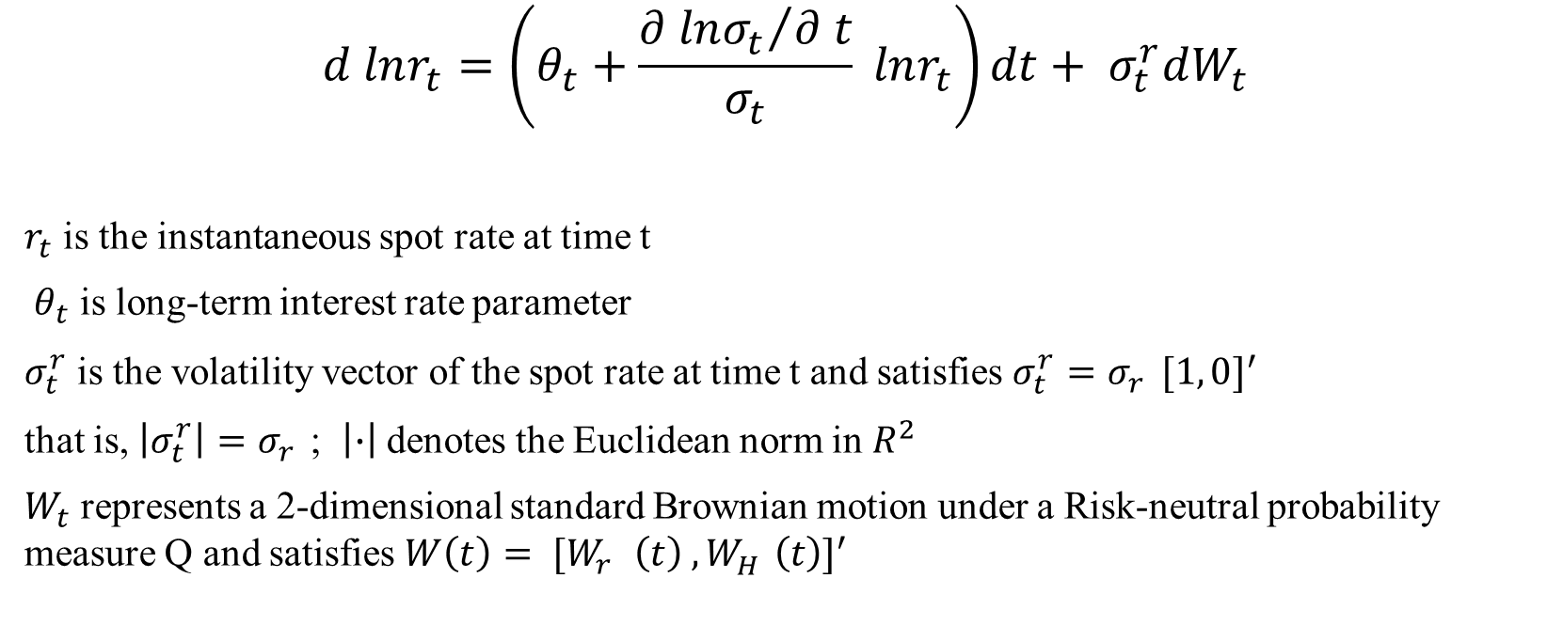
Interest rate process
$$d lnr_{t}=\left(θ_{t}+\frac{{∂ lnσ_{t}}/{∂ t}}{σ_{t}} lnr_{t}\right)dt+ σ_{t}^{r}dW_{t}$$
$r_{t}$ is the instantaneous spot rate at time t
$θ_{t}$ is long-term interest rate parameter
$σ_{t}^{r}$ is the volatility vector of the spot rate at time t and satisfies $σ_{t}^{r}=σ_{r}^{}{[1, 0]}^{′}$
that is, $\left|σ_{t}^{r}\right|=σ_{r}^{}$; $\left|∙\right|$ denotes the Euclidean norm in $R^{2}$
$W_{t}$ represents a 2-dimensional standard Brownian motion under a Risk-neutral probability measure Q and satisfies $W\left(t\right)= {[W_{r}^{}\left(t\right) ,W_{H}^{}\left(t\right)]}^{′}$

Slide 13
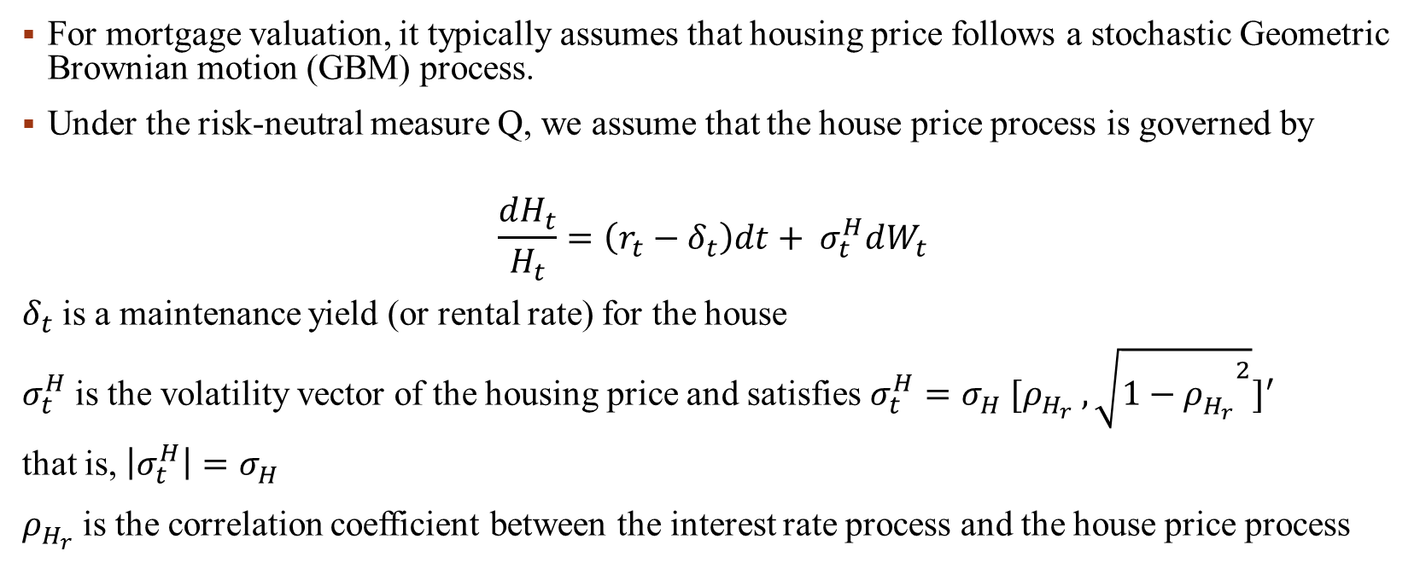
House price model
For mortgage valuation, it typically assumes that housing price follows a stochastic Geometric Brownian motion (GBM) process.
Under the risk-neutral measure Q, we assume that the house price process is governed by
$$\frac{dH_{t}}{H_{t}}=\left(r_{t}−δ_{t}\right)dt+ σ_{t}^{H}dW_{t}$$
$δ_{t}$ is a maintenance yield (or rental rate) for the house
$σ_{t}^{H}$ is the volatility vector of the housing price and satisfies $σ_{t}^{H}=σ_{H}^{}{[ρ_{H_{r}}^{} , \sqrt{1−{ρ_{H_{r}}^{}}^{2}}]}^{′}$
that is, $\left|σ_{t}^{H}\right|=σ_{H}^{}$
$ρ_{H_{r}}^{}$ is the correlation coefficient between the interest rate process and the house price process

Slide 14
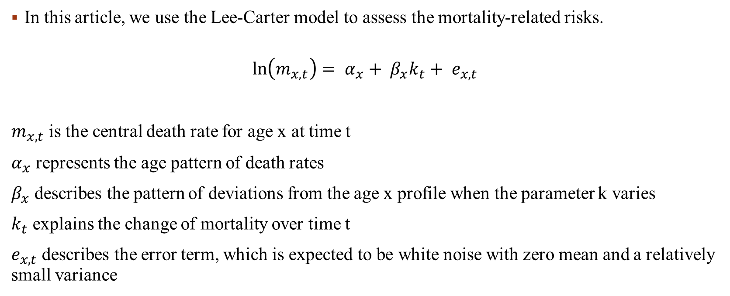
Mortality model
In this article, we use the Lee-Carter model to assess the mortality-related risks.
$$\ln\left(m_{x,t}\right)= α_{x}+ β_{x}k_{t}+ e_{x,t}$$
$m_{x,t}$ is the central death rate for age x at time t
$α_{x}$ represents the age pattern of death rates
$β_{x}$ describes the pattern of deviations from the age x profile when the parameter k varies
$k_{t}$ explains the change of mortality over time t
$e_{x,t}$ describes the error term, which is expected to be white noise with zero mean and a relatively small variance

Slide 15

Mortality model
This model is obviously over-parameterized. We use the singular value decomposition approximation (Lee and Carter, 1992) to fit the solutions of the parameters. To obtain a unique solution, a normalization conditions is imposed such that the $β_{x}$ terms sum to unity and the $k_{t}$ terms sum to zero, i.e.,
$$\sum_{t}{k_{t}}=0 and \sum_{x}{β_{x}}=1$$

Slide 16
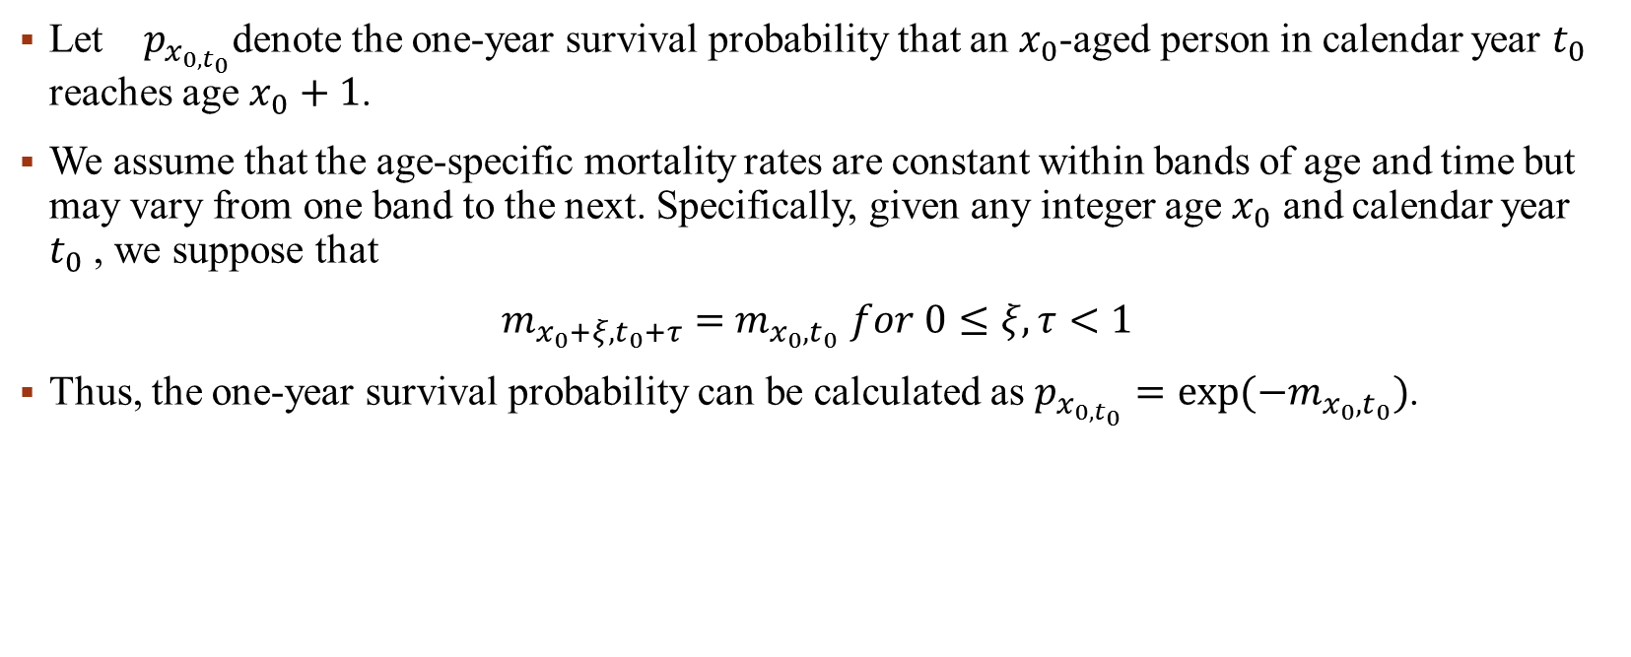
Mortality model
Let ${}_{}^{}{p_{x_{0,t_{0}}}}$denote the one-year survival probability that an $x_{0}$-aged person in calendar year $t_{0}$ reaches age $x_{0}+1$.
We assume that the age-specific mortality rates are constant within bands of age and time but may vary from one band to the next. Specifically, given any integer age $x_{0}$ and calendar year $t_{0}$ , we suppose that
$m_{{x_{0}+ξ,t}_{0}+τ}=$ $m_{{x_{0},t}_{0}}$ $for 0≤ξ,τ<1$
Thus, the one-year survival probability can be calculated as $p_{x_{0,t_{0}}}=exp⁡(−m_{{x_{0},t}_{0}})$.

Slide 17

Mortality model
Let${}_{t_{n}}^{}{p_{x_{0,t_{0}}}}$denote the n-year survival probability that an $x_{0}$-aged person in calendar year $t_{0}$ reaches age $x_{0}+n$, which is
$${}_{t_{n}}^{}{p_{x_{0,t_{0}}}}=exp\left(−\sum_{j=0}^{n−1}{m_{{x_{j},t}_{0}+j}}\right)=exp\left(−\sum_{j=0}^{n−1}{α_{x_{0}+j}+ β_{x_{0}+j}k_{t_{0}+j}}\right)$$

Slide 18
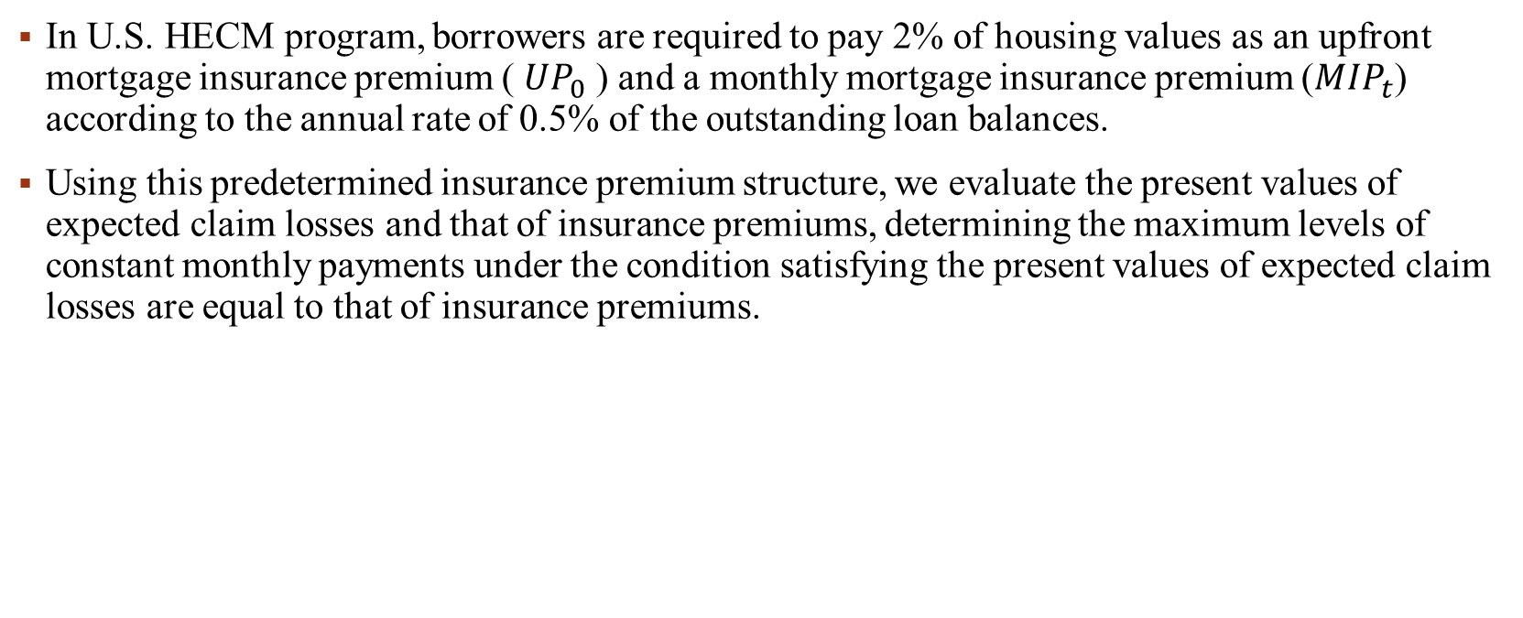
Reverse mortgage contracts
In U.S. HECM program, borrowers are required to pay 2% of housing values as an upfront mortgage insurance premium ( ${UP}_{0}$) and a monthly mortgage insurance premium (${MIP}_{t}$) according to the annual rate of 0.5% of the outstanding loan balances.
Using this predetermined insurance premium structure, we evaluate the present values of expected claim losses and that of insurance premiums, determining the maximum levels of constant monthly payments under the condition satisfying the present values of expected claim losses are equal to that of insurance premiums.

Slide 19
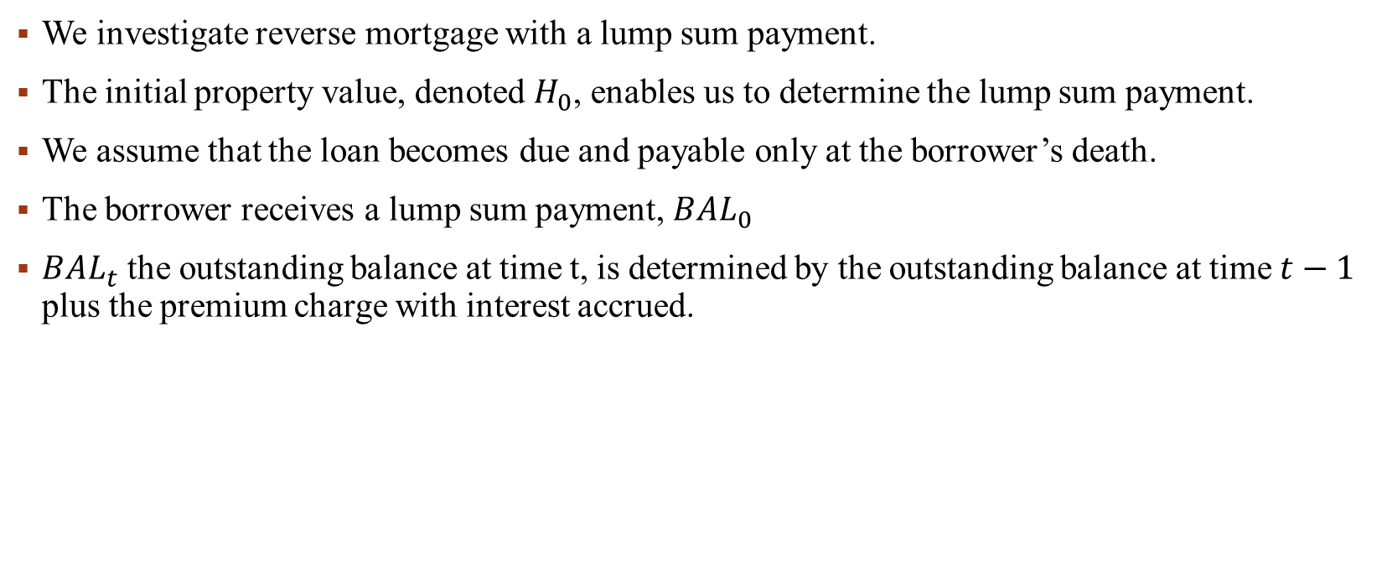
Reverse mortgage contracts
We investigate reverse mortgage with a lump sum payment.
The initial property value, denoted $H_{0}$, enables us to determine the lump sum payment.
We assume that the loan becomes due and payable only at the borrower’s death.
The borrower receives a lump sum payment, ${BAL}_{0}$
${BAL}_{t}$ the outstanding balance at time t, is determined by the outstanding balance at time $t−1$ plus the premium charge with interest accrued.

Slide 20

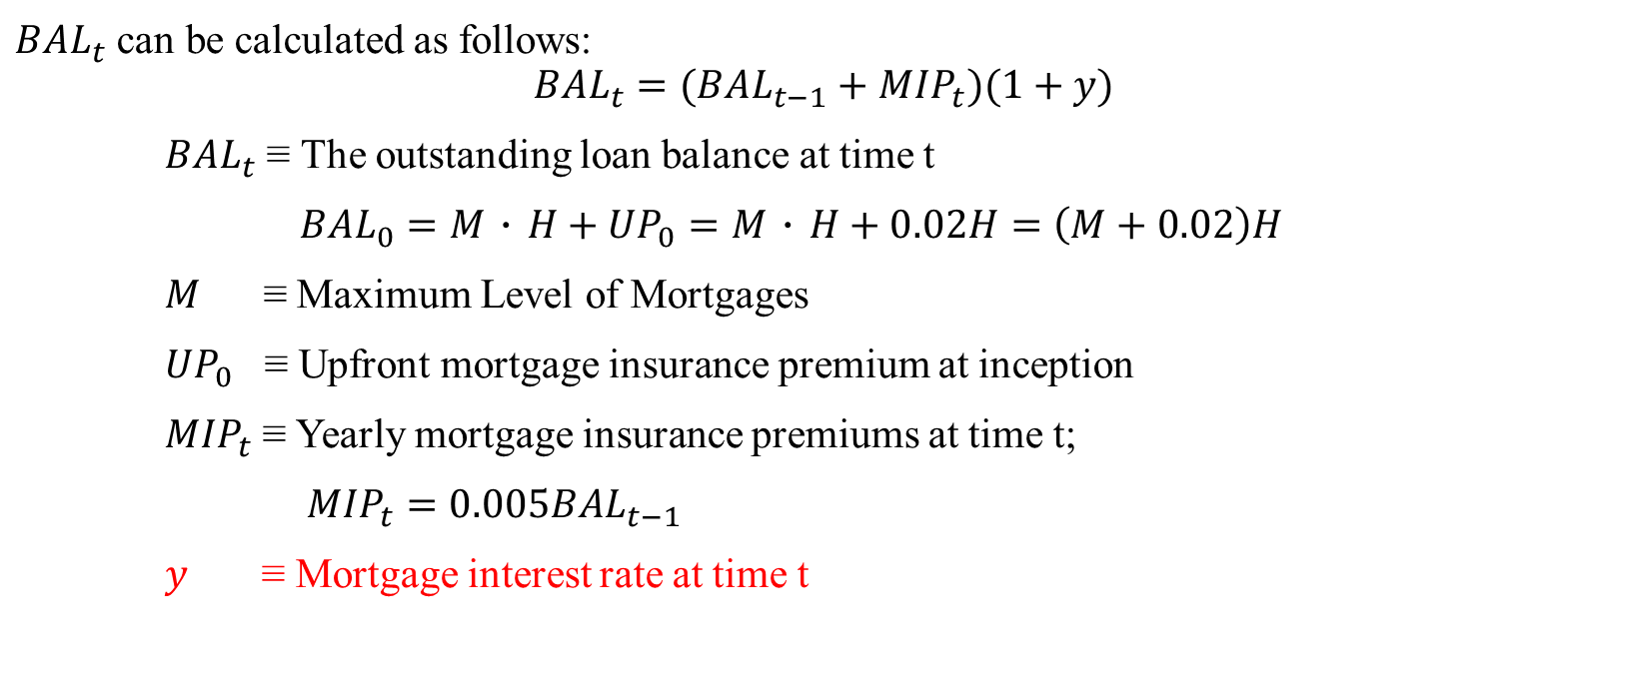
Reverse mortgage contracts
${BAL}_{t}$ can be calculated as follows:
$${BAL}_{t}=({BAL}_{t−1}+{MIP}_{t})(1+y)$$
${BAL}_{t}$ ≡ The outstanding loan balance at time t
${BAL}_{0}=M．H+{UP}_{0}=M．H+0.02H=\left(M+0.02\right)H$
$M$ ≡ Maximum Level of Mortgages
${UP}_{0}$ ≡ Upfront mortgage insurance premium at inception
${MIP}_{t}$ ≡ Yearly mortgage insurance premiums at time t;
${MIP}_{t}=0.005{BAL}_{t−1}$
$y$ ≡ Mortgage interest rate at time t
此處y應為隨時間變動的$y_{t}$

Slide 21


Reverse mortgage contracts
We can recursively obtain the expressions for ${MIP}_{t}$ and ${BAL}_{t}$ as follows:
$${BAL}_{t}={1.05}^{t}(M+0.02){(1+y)}^{t}H_{0}$$
$${MIP}_{t}=0.005{BAL}_{t−1}=0.005∗{1.05}^{t−1}(M+0.02){(1+y)}^{t−1}H_{0}$$
此處應為${1.005}^{t}$

Slide 22
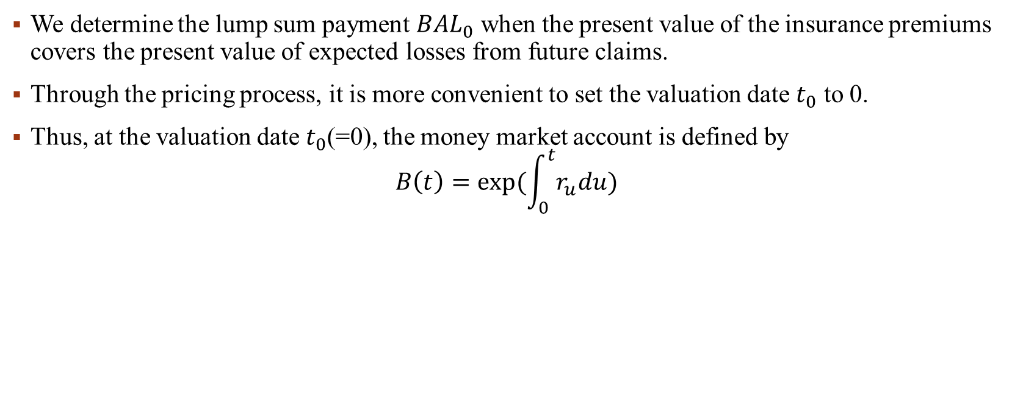
Pricing model
We determine the lump sum payment ${BAL}_{0}$ when the present value of the insurance premiums covers the present value of expected losses from future claims.
Through the pricing process, it is more convenient to set the valuation date $t_{0}$ to 0.
Thus, at the valuation date $t_{0}$(=0), the money market account is defined by
$$B\left(t\right)=exp⁡(\int_{0}^{t}{r_{u}du})$$

Slide 23
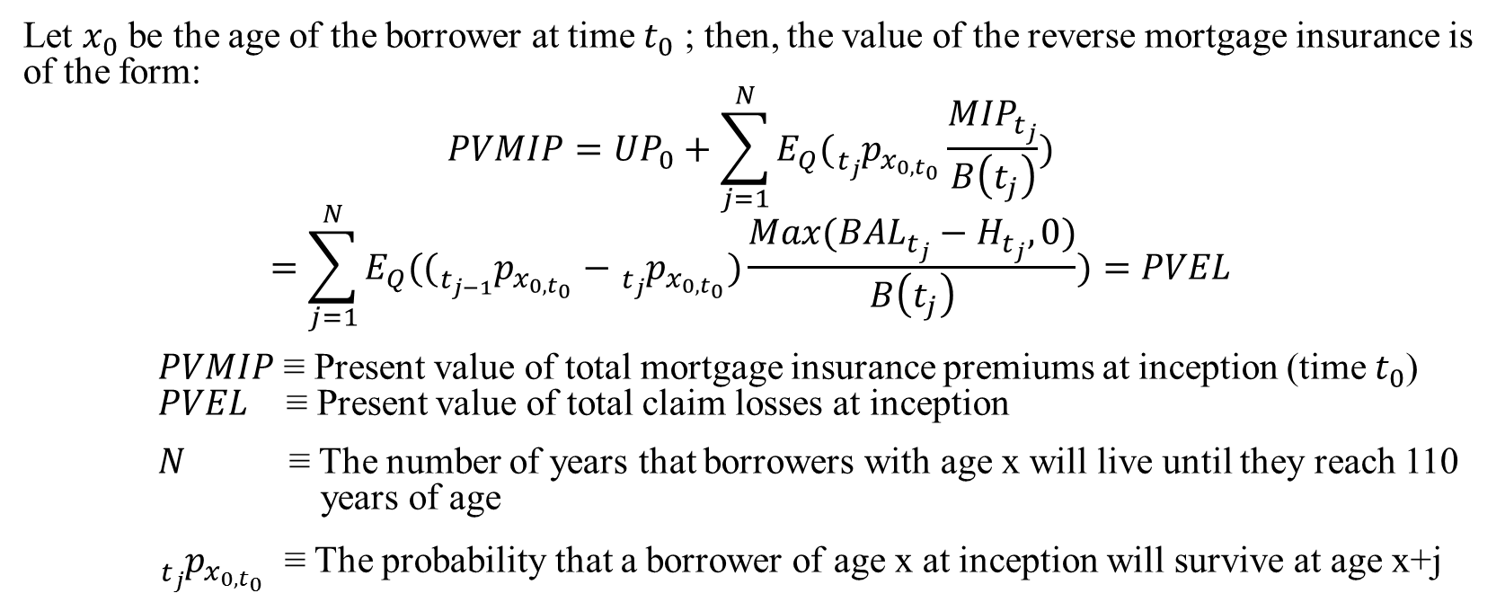
Pricing model
Let $x_{0}$ be the age of the borrower at time $t_{0}$ ; then, the value of the reverse mortgage insurance is of the form:
$$PVMIP={UP}_{0}+\sum_{j=1}^{N}{E_{Q}({}_{t_{j}}^{}{p_{x_{0,t_{0}}}}\frac{{MIP}_{t_{j}}}{B\left(t_{j}\right)})}$$
$$=\sum_{j=1}^{N}{E_{Q}(({}_{t_{j−1}}^{}{p_{x_{0,t_{0}}}}−{}_{t_{j}}^{}{p_{x_{0,t_{0}}}})\frac{Max({BAL}_{t_{j}}−H_{t_{j}},0)}{B\left(t_{j}\right)})}=PVEL$$
$PVMIP$ ≡ Present value of total mortgage insurance premiums at inception (time $t_{0}$) $PVEL$ ≡ Present value of total claim losses at inception
$N$ ≡ The number of years that borrowers with age x will live until they reach 110 years of age
${}_{t_{j}}^{}{p_{x_{0,t_{0}}}}$ ≡ The probability that a borrower of age x at inception will survive at age x+j

Slide 24
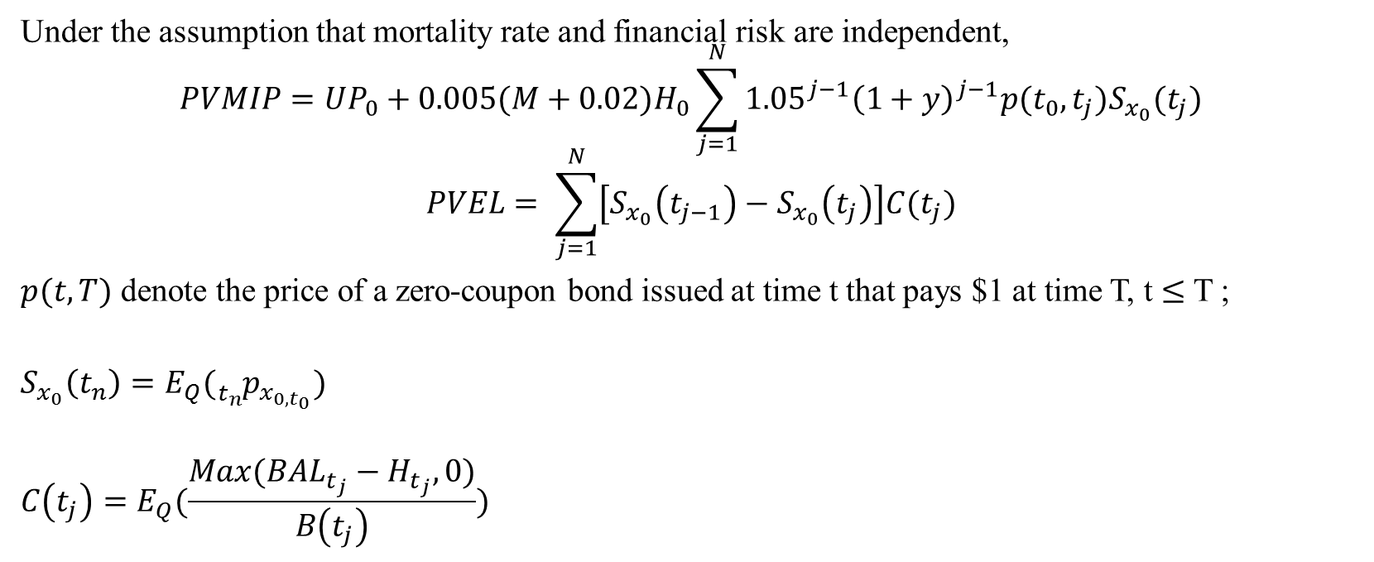
Pricing model
Under the assumption that mortality rate and financial risk are independent,
$$PVMIP={UP}_{0}+0.005(M+0.02)H_{0}\sum_{j=1}^{N}{{1.05}^{j−1}{\left(1+y\right)}^{j−1}p(t_{0},t_{j})S_{x_{0}}(t_{j})}$$
$$PVEL= \sum_{j=1}^{N}{\left[S_{x_{0}}\left(t_{j−1}\right)−S_{x_{0}}\left(t_{j}\right)\right]C(t_{j})}$$
$p(t,T)$ denote the price of a zero-coupon bond issued at time t that pays $1 at time T, t $≤$ T ;
$$S_{x_{0}}\left(t_{n}\right)=E_{Q}({}_{t_{n}}^{}{p_{x_{0,t_{0}}}})$$
$$C\left(t_{j}\right)=E_{Q}(\frac{Max({BAL}_{t_{j}}−H_{t_{j}},0)}{B\left(t_{j}\right)})$$

Slide 25
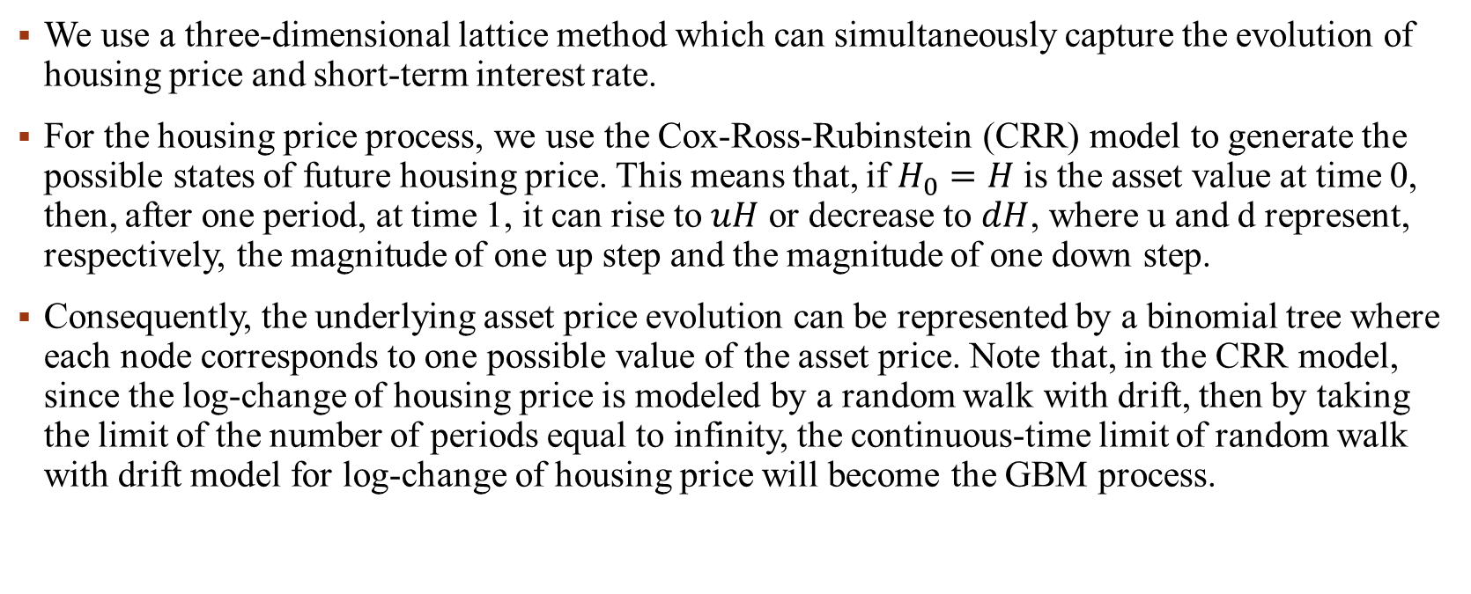
3d Lattice method
We use a three-dimensional lattice method which can simultaneously capture the evolution of housing price and short-term interest rate.
For the housing price process, we use the Cox-Ross-Rubinstein (CRR) model to generate the possible states of future housing price. This means that, if $H_{0}=H$ is the asset value at time 0, then, after one period, at time 1, it can rise to $uH$ or decrease to $dH$, where u and d represent, respectively, the magnitude of one up step and the magnitude of one down step.
Consequently, the underlying asset price evolution can be represented by a binomial tree where each node corresponds to one possible value of the asset price. Note that, in the CRR model, since the log-change of housing price is modeled by a random walk with drift, then by taking the limit of the number of periods equal to infinity, the continuous-time limit of random walk with drift model for log-change of housing price will become the GBM process.

Slide 26
3d Lattice method
For the process of short-term interest rates, we use the Black-Derman-Toy model to generate the possible states of future spot rates. The BDT model is a one-factor short-rate (no-arbitrage) model — all security prices and rates depend only on a single factor, the short rate — the annualized one-period interest rate. The current structure of long rates (yields on zero-coupon Treasury bonds) for various maturities and their estimated volatilities are used to construct a tree of possible future short rates.
Similarly, when the number of periods approaches to infinity, the process of short-term interest rates governed by BDT model become a lognormal process.

Slide 27
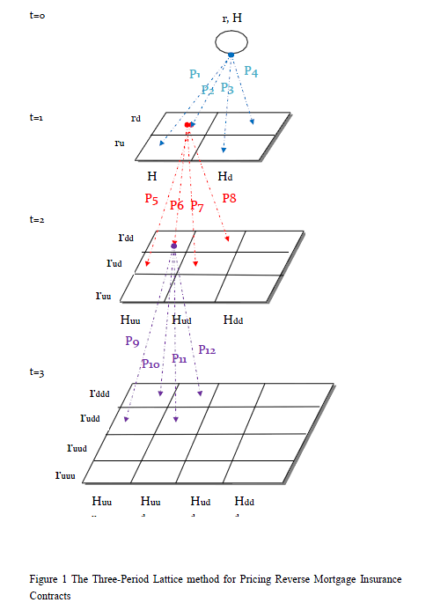

Slide 28

3d Lattice method
Combining the CRR model and BDT model, Figure 1 depicts the three-period lattice model to numerically obtain the values of $C\left(t_{j}\right)$.
The initial advance ${BAL}_{0}$ can be determined by setting the present value of total expected claim losses equal to the present value of the premium charges, namely $PVMIP=PVEL$.

Slide 29
Thanks for your attention

